Slide 2
QUB Undergraduate Fees 2025/26
The following tuition fee information refers to full-time NI, GB and ROI students only, for academic year 2025/26.
Students who normally live in Northern Ireland or Republic of Ireland, will be charged tuition fees of £4,855 per annum.
Students who normally live in England, Scotland and Wales (GB Students), will be charged tuition fees of £9,535 per annum.
All tuition fees will be subject to an annual inflationary increase in each year of the course. Fees quoted relate to a single year of study.

Slide 3
Payment Options
During enrolment, undergraduate students will normally pay their tuition fees in the following ways:
Tuition Fee Loan. NI, GB & ROI students can apply for a tuition fee loan for Undergraduate study.
Payment Plans can be set up through our Payment Plan provider Flywire, which will provide students with the option to pay in instalments.
Further information is available at www.qub.ac.uk/Study/Feesandfinance
In exceptional circumstances where sponsorship is available
Third Party Sponsor. Evidence of sponsorship or scholarship from a government or other official organisation, must be provided at enrolment and registration.

Slide 4
Student Loans and Grants
Available Support
NI students can apply for fee and maintenance funding online through SFNI
EU students can apply for fee loan only support. Postal applications only using form EU25N.
Eligibility
SFNI will determine eligibility. Students should contact their local SFNI office if they have any queries about eligibility
SFNI Eligibility Criteria Presentation 25-26
Application Process
SFNI video explaining the application process
Queries about support, eligibility and application process should go directly to SFNI:
0300 100 0077

Slide 5
SFNI link to all UG finance available:
Types of Finance
Available Support
Tuition Fee Loan –
  up to £4,855 per year for study at NI universities,
  £9,535 for study at universities in England, Scotland and Wales
Maintenance Loan – based on household income
Maintenance Grant – for lower-income households
Special Support Grant
Extra Help – e.g. Disabled Students’ Allowance, Childcare Grants
Studying in the Republic of Ireland
Students who normally live in Northern Ireland and choose to study at a relevant institution of higher education in the Republic of Ireland (public university or college) are not charged a tuition fee, however they are required to pay a student contribution charge. SFNI offer a Student Contribution Loan to help cover this charge.

Slide 6
Applying for a fee / maintenance loan
All eligible full-time students can apply for a loan to cover tuition fees.
Students from Northern Ireland can register and apply online at: https://www.studentfinanceni.co.uk
Students from the Republic of Ireland cannot apply online. ROI students can download the student finance application (EU25N) available at: https://www.studentfinanceni.co.uk
Students from England & Wales can register and apply online at: https://www.gov.uk/student-finance
Students from Scotland can register and apply online at: https://www.saas.gov.uk/

Slide 7
Quick Quide for Students
Apply via studentfinanceni.co.uk
Opens to new Undergraduate students March of each year
New students should create an online account when applying
Provide income details up to thresholds only
Apply early!!! You do not need a confirmed place at University to make an application. Late applications may delay payments in time for the start of your course.
Fee loan payments are paid direct to your university or college on your behalf and you only have to start repaying it once you've left your course and are earning over £26,065 a year.

Slide 8
Year 14 - Do your homework and apply to UCAS
September - Course Registration
  Do your research on courses and the estimated costs for study at your proposed university or college. Check www.studentfinanceni.co.uk to determine the level of support available. Also make application to UCAS regarding your course choices.
  Enrol at your chosen university or college. Remember to save a copy of your Financial Notification letter from your SFNI account as your university or college may need to see it.
From March onwards apply to Student Finance NI
  Apply online at www.studentfinanceni.co.uk with your first choice university or college and course
  At the same time your parents/sponsors should also complete their details online
  You don't have to wait until you receive an offer of a place from your university or college to apply for your student finance.
3-5 days after Registration your financial support is paid
  The Student Loans Company will pay the first instalment of your student finance into your bank account.
Ongoing throughout the year
  Remember that you must let SFNI know about any changes to your circumstances that may affect your entitlement to student finance. For example, you must tell them if you change to another university or if your household changes, etc. You can maintain your account online or download a 'Change of Circumstances' form from the SFNI website.
April onwards - How much will I get?
  Providing you've completed your application in full, and submitted all relevant documentation such as eligibility evidence and parental details, Student Finance NI will determine your eligibility, assess your application and let you know what finance you are entitled to.
August - Exam Results
  If you are not successful in gaining a place on your 1st choice of course but obtain a place on another full time HE course, you can go online to make the change at www.studentfinanceni.co.uk in your online account. You can also contact your local Student Finance NI office to advise of this change.

Slide 9
How Income Affects Support
Household Income levels affects Maintenance Loan and Grant eligibility
The max grant available is £3,475 per year and dependent on household income. A grant is not repaid whereas a loan is.
Income < £19,203 → Full grant
Income up to £41,065 → Grant reduced
Income > £41,065 → No grant

Slide 10
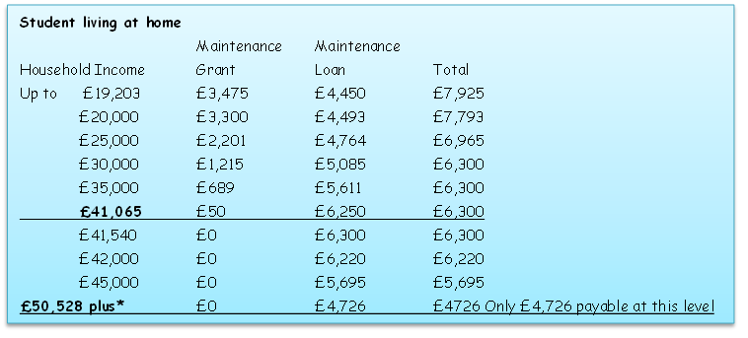
Maintenance Loan and Grant Support Income Levels SFNI 2025/26 – Living at home

Slide 11
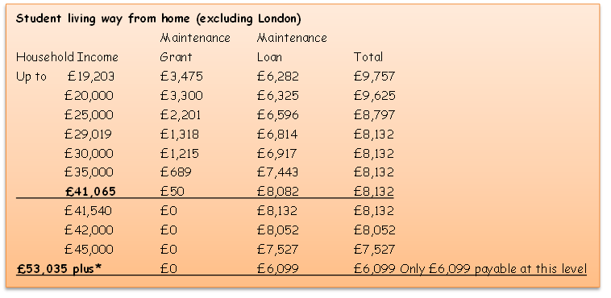
Maintenance Loan and Grant Support Income Levels SFNI 2025/26 – Living away from home (exc London)

Slide 12
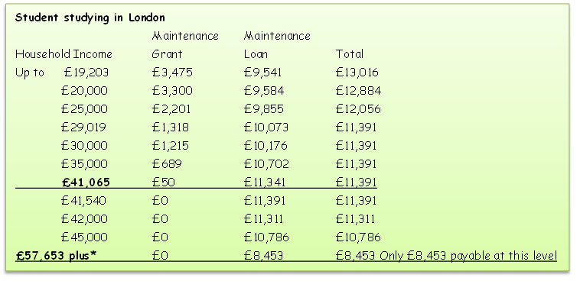
Maintenance Loan and Grant Support Income Levels SFNI 25/26 – Studying in London

Slide 13
Nursing & Midwifery Courses – Student Bursary Information
Eligible students may have their fees paid for the duration of the three-year degree by the Department of Health (DoH) and may also receive a bursary – this is known as a ‘commissioned’ place. The bursary is intended to assist with daily living costs incurred while training and is awarded for each year of the three-year course; it will normally be paid in monthly instalments.
To be eligible for a commissioned place, applicants must be an NI or EU national living in NI with settled status. Further conditions may apply.
Application forms are dispatched after the university has confirmed your place on the course.
Other Allowances
Dependency Allowances – you may be eligible to claim this allowance for a partner, other adult or children who are financially dependent on you; this allowance is means-tested and you will be required to provide evidence to support your claim.
In addition, if you are eligible for these you may be entitled to a Parents Learning Allowance and/or Childcare Allowance.
Disabled Students’ Allowance – may be payable if you have a disability and need extra help to complete your course. The allowance can help with specialist equipment, a non-medical helper or other course-related costs.
Clinical Placement Expenses – as part of your course, student nurses and midwives will complete clinical placements at healthcare organisations throughout Northern Ireland. When the cost of travelling to these placements is greater than normal daily costs to and from the university, students may claim for any additional costs incurred.
Contact Information
For further information or any queries on the HSC student bursary contact:
Tel: 02895363988 e-mail: studentnurse.bursaries@hscni.net

Slide 14
The Department of Health (DoH) offers a Social Work Student Incentive Scheme to help with the costs associated with completing the Degree in Social Work in NI Universities.
Eligibility Criteria
Applicants for the scheme must be:
living in Northern Ireland
accepted onto a full-time Degree in Social Work course in Northern Ireland which is approved by the Northern Ireland Social Care Council (NISCC)
Registered with the NISCC as a student social worker
Successful applicants to the scheme will receive an annual payment of £4,000 and an allowance of £500 towards travel costs associated with practice placements.
How to Apply
Once you have a confirmed place your University will forward an application pack to you. Guidance on completing this will be included.
More information regarding the Social Work Student Incentive Scheme can be provided by
oss@health-ni.gov.uk
NI Degree in Social Work – Student Incentive Scheme

Slide 15
What Scholarships are available
Entrance Scholarship Competition
All students entering the University in the academic year 2024-25 for the first time to undertake a primary degree, and who have achieved at least three ‘A’ grades at A-Level (including AVCEs), are eligible to enter the University’s annual A-Level Entrance Scholarship Competition
Scholarship Opportunities | Academic & Student Affairs | Queen's University Belfast
Sports Awards
Sports Bursary and Academy Scholarship Awards
Elite Athlete Programme
Sports Academy Scholarship
Scholarships — Queen's Performance Sport

Slide 16

QUB Financial Support
for Students
Further support is provided through the Queen's Bursary
Students coming from families earning under £19,204 per year will receive a one-off payment of £490 each
The QUEEN'S BURSARY is paid directly to an eligible student's bank account in one instalment, normally by February. Students will receive a letter, notifying them that they are eligible, prior to payment of the award in February.
The entitlement of full-time NI undergraduate students to the Queen’s Bursary is assessed by the Education Authority on the basis of household income.
Financial support is available to students
experiencing financial difficulties whilst
studying. Funding comes from the
Department for the Economy (DfE).
Who is eligible for the Support Fund?
All full-time and part-time (25% of equivalent full-time course) Northern Ireland and Great Britain undergraduates
You must be in receipt of your full Student Loan entitlement, both tuition and maintenance loans.
You have received your first payment of your student maintenance payment.

Slide 17


Cost of Living
Benefits of studying in Northern Ireland
Best Value City for Student Living
Belfast is the UK’s most affordable student city (Natwest Student Living Index 2024)
Cheaper cost of living
£178 per month cheaper for student living costs in NI compared to the UK average (Save the Student National Student Money Survey 2024
Tuition Fees for NI students 25/26:
Study in NI = £4,855
Study in GB = £9,535
Fees generally increase annually in line with inflation and UG courses will typically be 3-4 years in length
LINKS:
The Affordable Student Experience: Belfast vs London vs Manchester
Student Budgeting and Tips: Making Your Money Go Further
Part-time and casual work at Queen’s
Student life | Study | Queen's University Belfast

Slide 18


Work While You Study
A part-time job on campus could be a great way to meet new people and get more involved in the Queen’s community.
As one of the biggest student employers in Belfast, there’s a wide range of roles you can apply for at Queen’s. These include roles like student ambassador, tour guide and various hospitality roles. And you’ll be working for the university, so you can be sure your employer will understand the demands of your degree.
Through QWork, you can register your interest in working on casual basis on QUB Campus, view opportunities, apply for and manage your assignments.
Work while you study | Study | Queen's University Belfast –
Qworks – Working at the University
QWork

Slide 19
Additional Resources
QUB Financial Support:
Student Support Fund
Queen's Bursary
Nursing & Midwifery Bursary
NI Direct Health Professional Courses
SFNI DoH and NHS funded courses factsheet 2025-26
Social Work Incentive Scheme
NI Direct Careers in Social Care
Guidance for School Leavers on Student Finance application process:
Student Finance Videos | Education Authority Northern Ireland
Student Loan applications:
www.studentfinanceni.co.uk

Slide 20

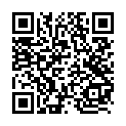


Contact Us
Student Finance Office
Queen’s University Belfast
One Elmwood Student Centre
University Road
Belfast
BT7 1NN
+44 (0)28 9097 2855
StudentFinance@qub.ac.uk
www.qub.ac.uk/Study/Feesandfinance/
Got a Question?
Search our frequently asked questions for answers to common queries: https://www.qub.ac.uk/Study/Feesandfinance/fees-and-funding-faqs/

